Slide 1
Exploratory Data Analysis (EDA) & Linear Regression Model
Anshu Anamika

Slide 2
Introductiom
Data set contains data about flights leaving from JKF (John F. Kennedy International airport, New York City) Airport between Nov 2019-Dec2020
The Taxi-Out Time is duration between gate out (moving from the parking area) time and take off (wheels off) time.
Taxi-Out prediction has been an important concept as it helps in calculating Runway time and directly impact the cost of the flight
Rows :28820, Columns: 23 (days, week,month, weather conditions like temp, humidity, wind speed, and flight details importantly delays and taxi out time,

Slide 3
Initial steps of EDA
Check
Check for missing values/null values
Check
Check for data type
Check
Check description (mean, std etc.) and correlation

Slide 4
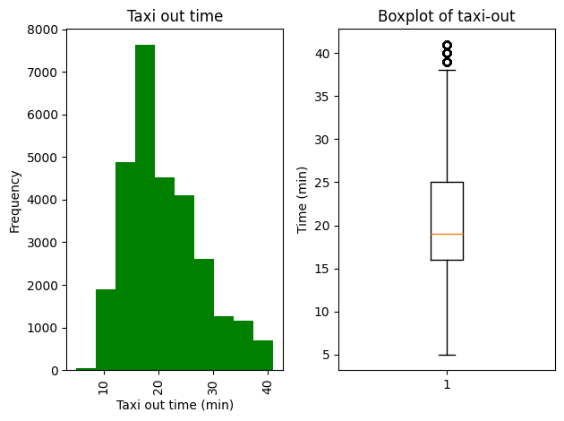
How is taxi-out time data distributed?

Slide 5
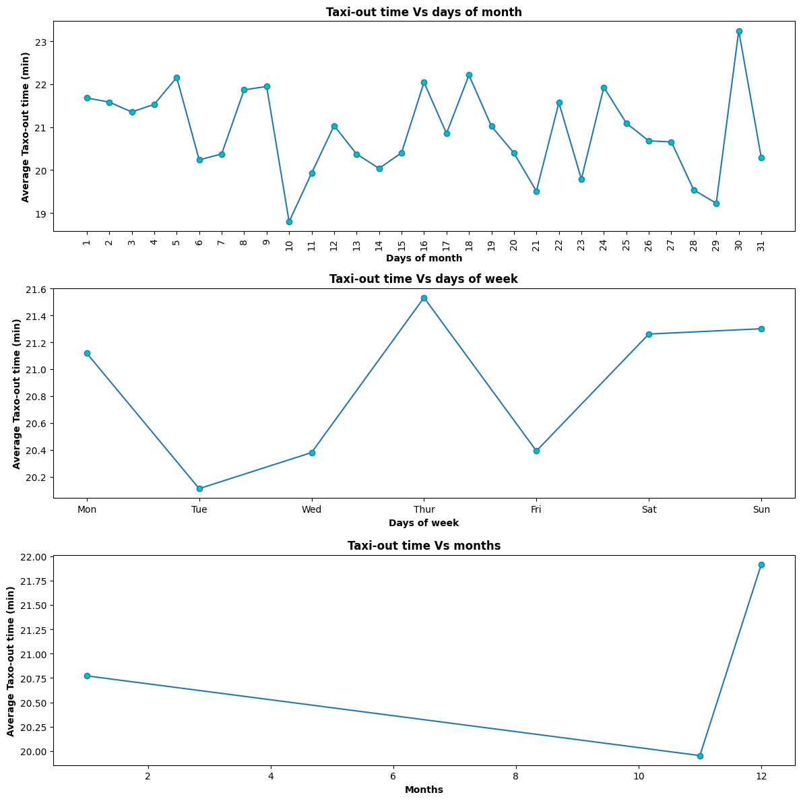
Any relationship between Taxi-out and days, week and month?

Slide 6
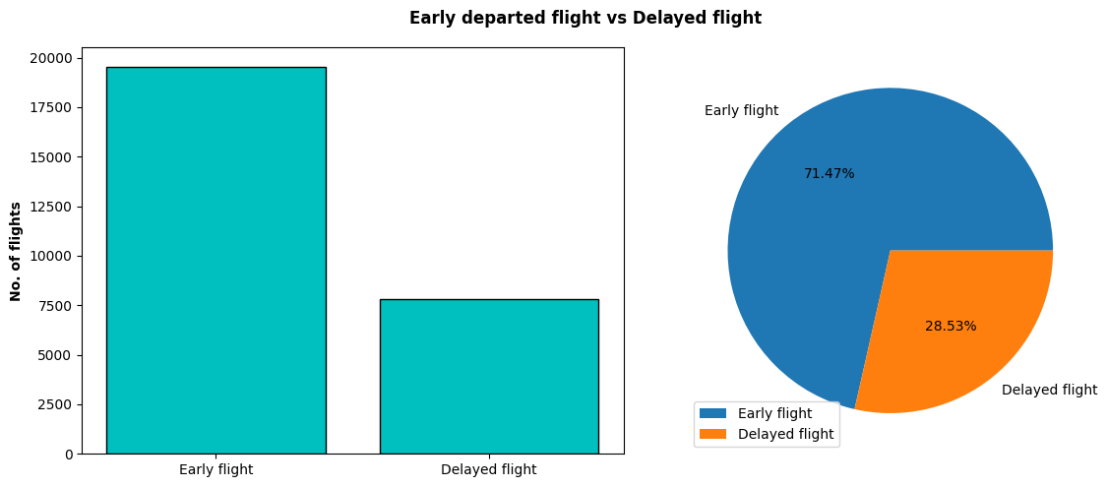
How many flights are delayed or departed early?

Slide 7
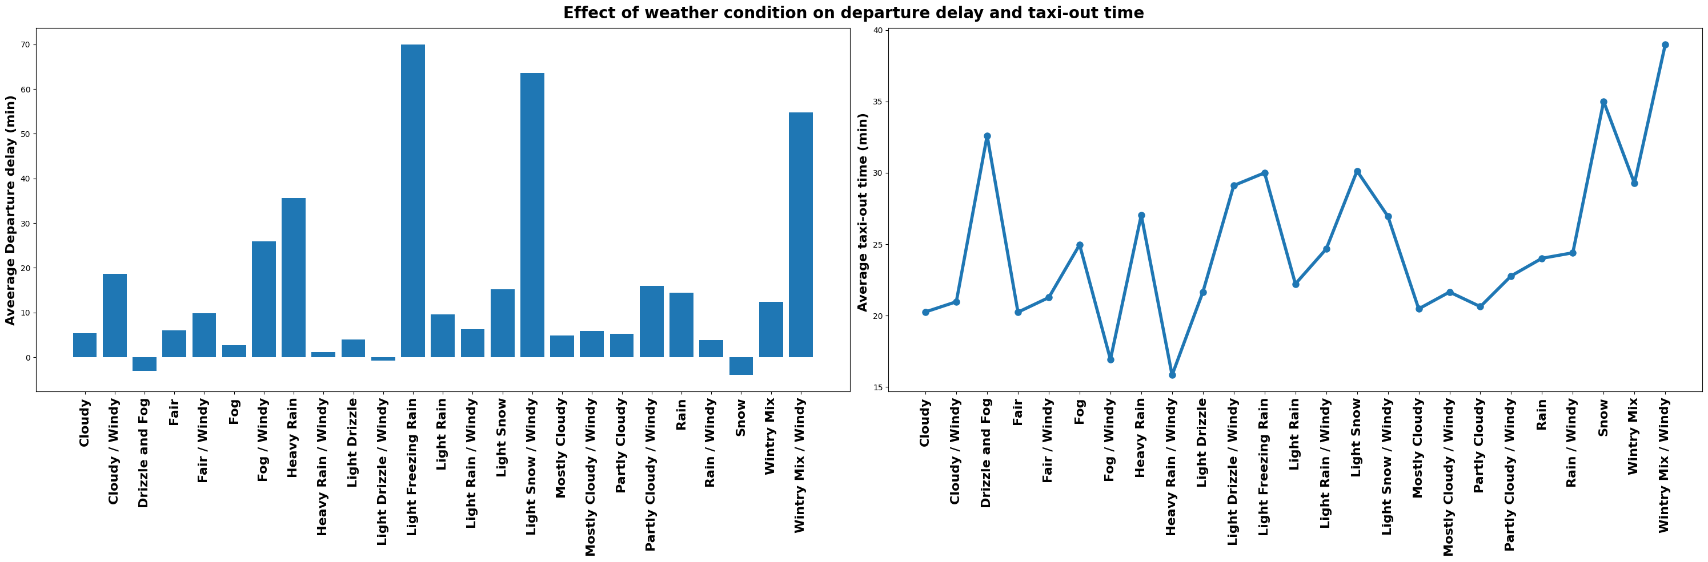
How is weather condition affecting taxi-out time and departure delay?

Slide 8
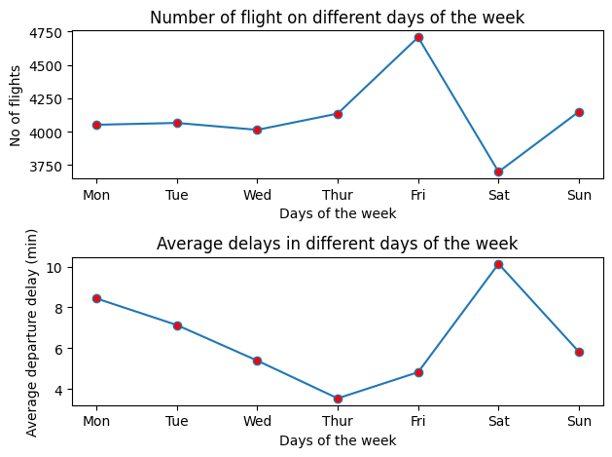
Any relation between no. of flight and departure delays?

Slide 9
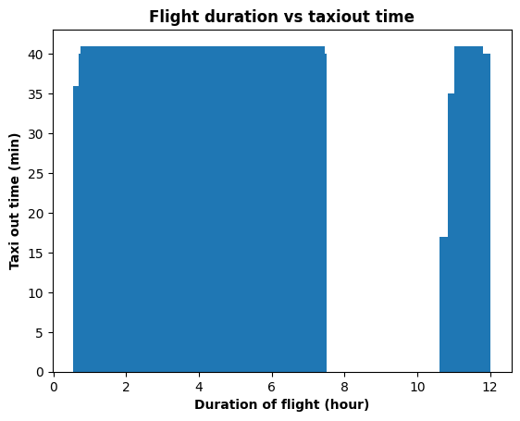
Any relationship between flight duration and taxi- out time?

Slide 10
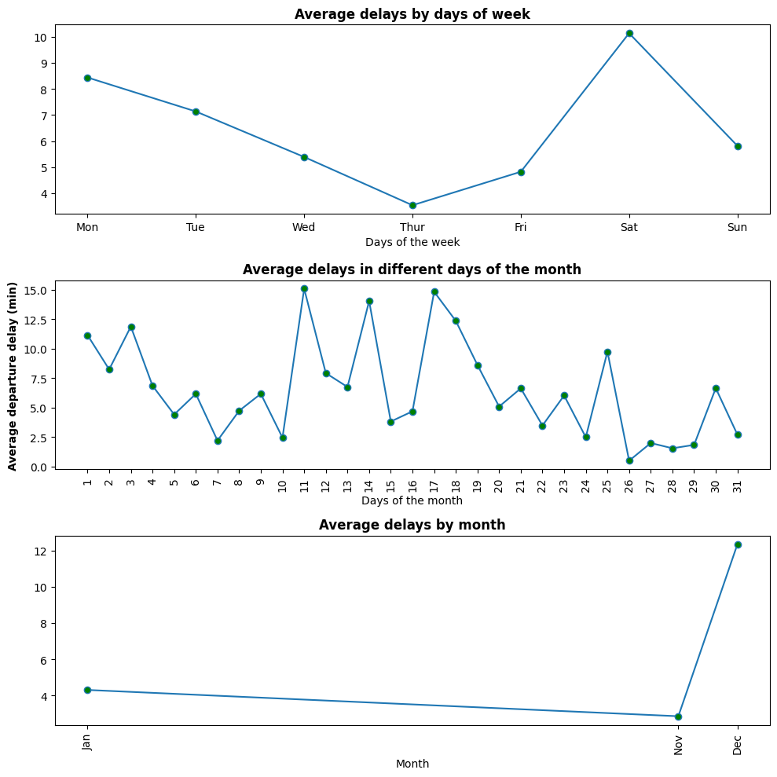
How is departure delay related to the days, week and month?

Slide 11
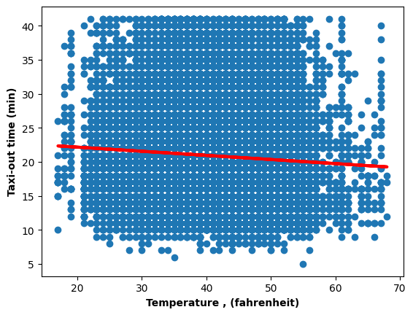
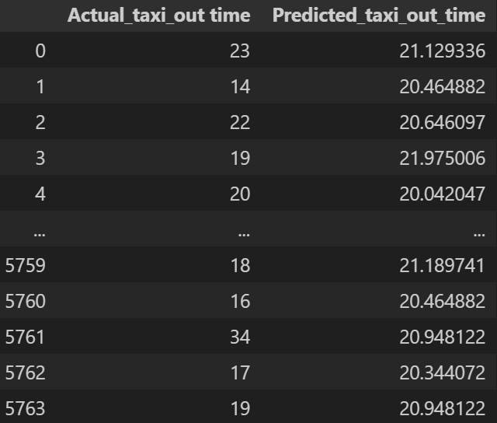
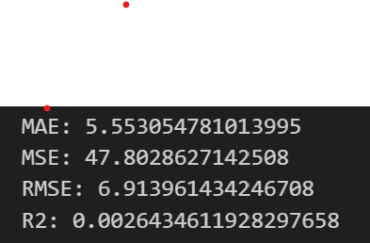
Simple linear regression model

Slide 12
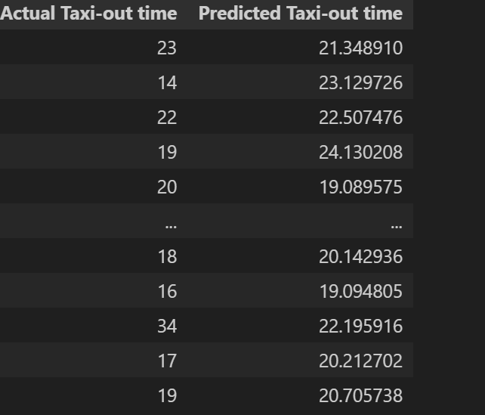
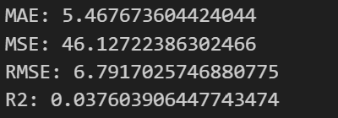
Multilinear regression model for predicting Taxi-out time (based on duration of flight, temp, dew point, humidity, wind speed, wind gust, pressure)

Slide 13
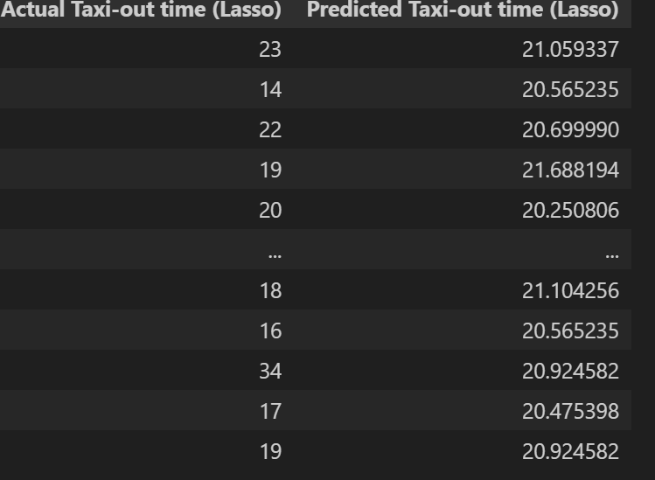
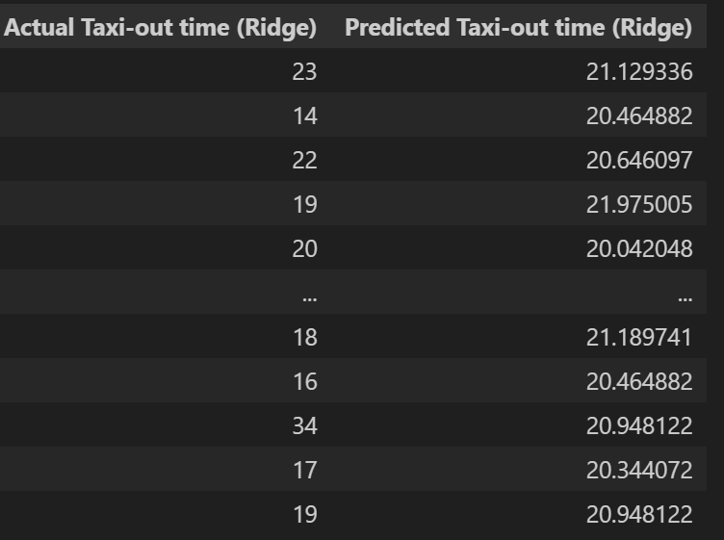
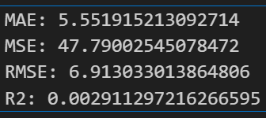
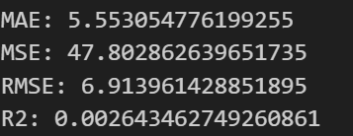
Linear regression, Lasso and Ridge comparison

Slide 14
Conclusion
This data set is not appropriate for taxi-out prediction by linear regression model
We can add some more variables which are highly correlated with Taxi-out time
We can use other models to predict taxi-out time which I am going to learn soon.

